Slide 1
Customer Review Sentiment Analyzer
Industry Project Presentation
Presented by: Srajal Yadav
Company: MPOnline Limited, Bhopal
Guide: Mr. Atul Kumar Gupta

Slide 2
Project Overview
Machine Learning based sentiment analysis system
Classifies reviews into Positive, Neutral, and Negative
Uses NLP and TF-IDF techniques
Developed using Python and Streamlit

Slide 3
Problem Statement
Manual review analysis is time-consuming
Large e-commerce platforms receive huge review volumes
Businesses need automated sentiment understanding
Goal: automate customer sentiment classification

Slide 4
Objectives
Build a sentiment classification system
Perform text preprocessing using NLP
Train and evaluate ML models
Develop user-friendly Streamlit interface

Slide 5
Dataset Information
Dataset: Amazon Product Reviews (Kaggle)
Total records: 50,000
Review ratings mapped to sentiments
Positive: 76.8%, Negative: 15.1%, Neutral: 8.1%

Slide 6
Technologies Used
Python
pandas and NumPy
scikit-learn
NLTK
Streamlit
VS Code and GitHub
Flask

Slide 7
Preprocessing Pipeline
Lowercasing text
Removing HTML tags and URLs
Removing stop words
Lemmatization using NLTK
TF-IDF vectorization

Slide 8
Machine Learning Models
Naive Bayes
Logistic Regression
Linear SVM
Compared using Accuracy and F1-score
Probability calibration for UI confidence scores

Slide 9
Model Performance
Naive Bayes Accuracy: 83.71%
Logistic Regression Accuracy: 85.36%
Linear SVM Accuracy: 86.23%
Linear SVM achieved best performance

Slide 10
System Workflow
Dataset Collection
Preprocessing
Feature Extraction
Unit Testing
Model Training
Evaluation
Deployment via Flask API & Streamlit

Slide 11
Challenges Faced
Class imbalance in dataset
Long preprocessing time
Optimizing NLP pipeline
Handling large review texts
Developing rigorous unit tests for edge cases in text cleaning

Slide 12
Future Enhancements
Cloud deployment
Real-time review monitoring
Multilingual sentiment analysis
Deep Learning models like BERT

Slide 13
Conclusion
Successfully built sentiment analysis application
Achieved good classification accuracy
Developed interactive Streamlit interface
Improved practical NLP and ML understanding

Slide 14
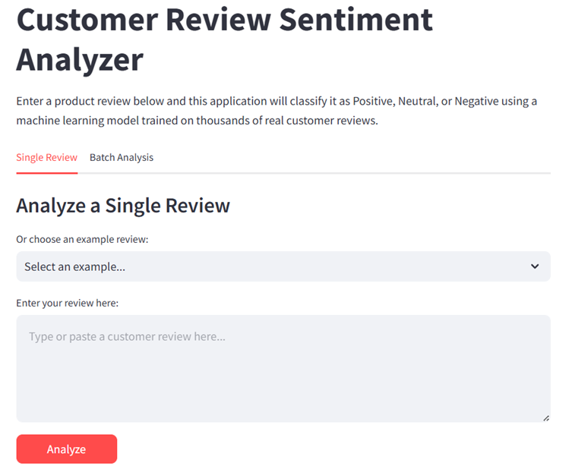
Streamlit Home Page

Slide 15
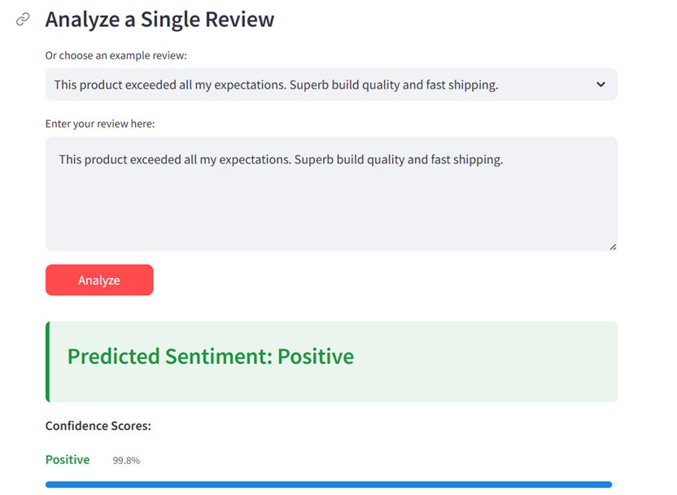
Single Review Prediction

Slide 16
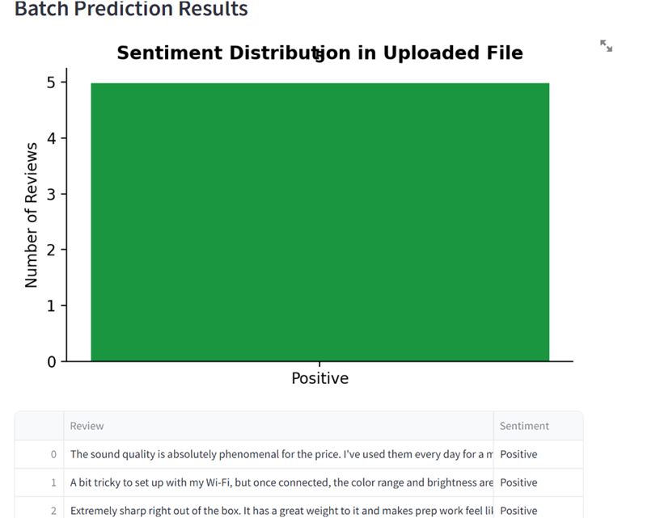
Batch Analysis Result

Slide 17
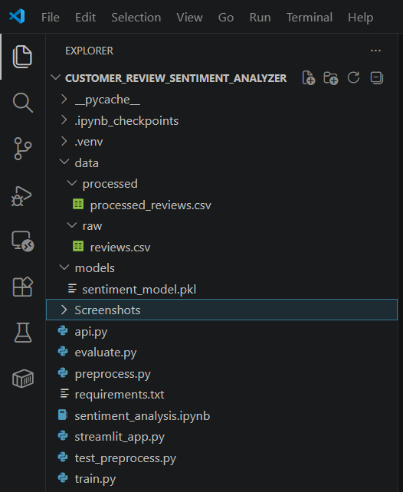
Project Structure in VS Code

Slide 18
Thank You

